Slide 1
Java Programming – Version Control
Notes:
2 - Describe and communicate hazards associated with this lesson
Health & Safety
Check trailing cables
Identify any visible hazards
Store student bags safely
Enforce no drinking rule next to electrical equipment
No mobile phone use
Equality & Diversity
Identify learners with specific needs
Provide all learners with same level of support where appropriate.
Safeguarding
Every Child Matters and college procedures
Ensure all learners have consent forms in case of photo / video work

Slide 2
This Lesson we will be…
Identifying the uses of version control.
Creating GitHub accounts.
Developing simple Java applications and pushing them to online repositories.
Notes:
2
Agree the Learning Outcomes
Including LO for functional skills development
LO for ELB, employment or enterprise skills development
Formative assessment strategies to be used in this session:
Q&A direct and volunteer
Peer assessment
Observation
Resources:
Computers
Whiteboard
PowerPoint
Internet
Eclipse Mars IDE
Embedding of literacy and numeracy development:
Select and use different types of texts to obtain and utilise relevant information;
Read and summarise, succinctly, information/ideas from different sources;
Identify the purposes of texts and comment on how meaning is conveyed;
Detect point of view, implicit meaning and/or bias;
Learning Outcomes for Effective Learner Behaviours, Employment or Enterprise Skills Development
Attitudes – Identify the correct attitudes
Skills – Apply the necessary skills
Knowledge – Use the knowledge gained
Introduction (Tutor)
Discuss Learning outcomes
Question students understanding
Consider groupings
Introduction (student)
Discuss Learning outcomes
Listen and ask questions
Volunteer answers to questions

Slide 3

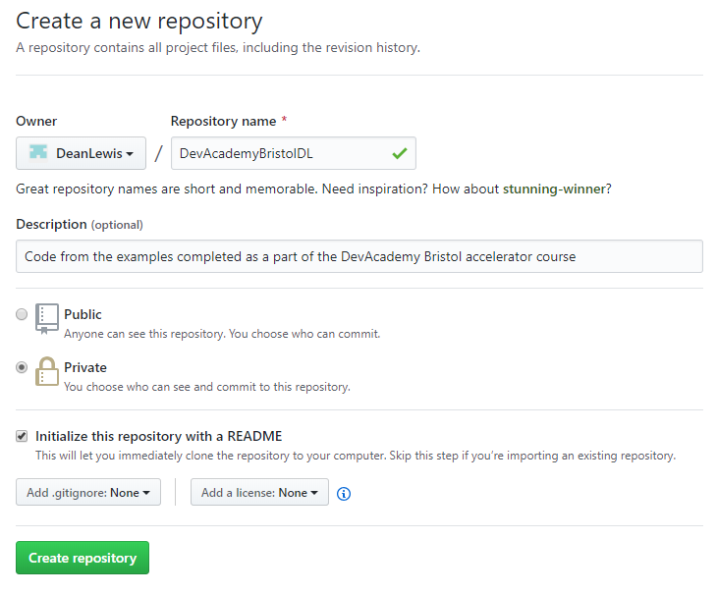
GitHub
Go to github.com
If you do not already have an account, create one now.
Create a new repository.

Slide 4
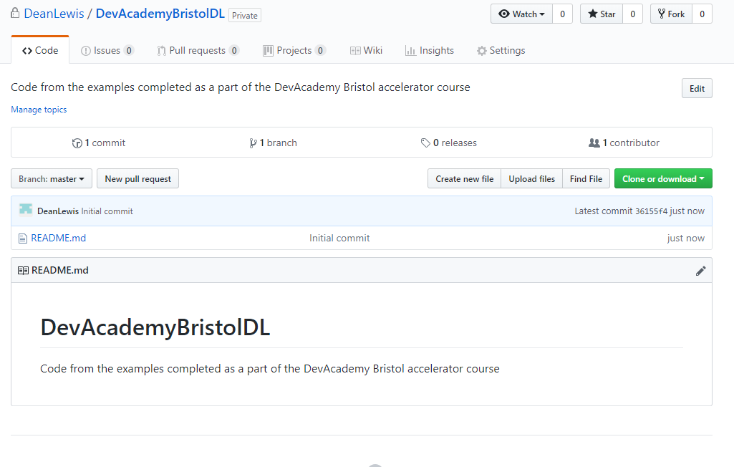

Slide 5
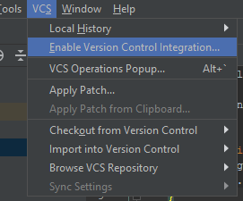
Version Control
Back in IntelliJ select VCS → Enable version control integration.
Select Git from the popup that appears.

Slide 6
GitHub for Desktop
We need to install github for desktop.
Using google, search for ‘GitHub for Windows’
Download and install.
Search for ‘gitbash for windows’
Download and install – default settings.

Slide 7
Terminal
Navigate to the terminal window.
Type the following command:
git init
git add *
git commit –m ”initial Commit”
If you get the error: “git is not a recognised…”
https://stackoverflow.com/questions/4492979/git-is-not-recognized-as-an-internal-or-external-command

Slide 8
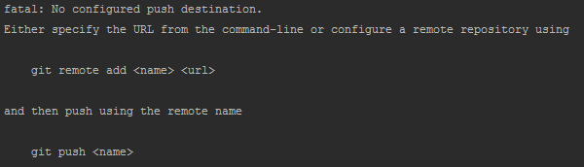
Terminal
Next we need to push the changes to the online repository.
Before we can do this however, we need to first define the destination.

Slide 9
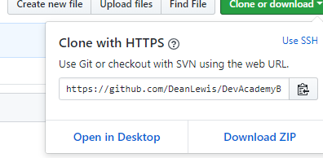
Terminal
To add a remote repository, you must first create the repository on GitHub.
Create a new repo and call it DevAcademyBristol(Initials/name)
Do not add a README, gitIgnore or licence.
Next get the url for your repository.

Slide 10

Terminal
In the terminal window in IntelliJ enter the following command:
Verify it has worked with the following command:

Slide 11
Terminal
Now, before we make our first commit, we need to make sure there are no discrepancies between the two repositories.
Even though the online repo should be empty, we will pull from it first to ensure there are no conflicts.
Next, we will stage the changes, you can think of this as a sort of save for now.

Slide 12
Terminal
Now that we have staged the changes, we can make our first commit.
Now, check your online repository.
It’s empty!!!!
When we committed the changes, all we did was commit them to the local repository, we also need to make sure we ‘push’ the changes to the online repo.
You may be prompted to log in to github at this point.

